Slide 1
Bayer Global Channels and Content
Quick Analysis
of LinkedIn
July 2024
Data Date Range: Jan 1, 2023 - March 31, 2024
Notes:
Link to spreadsheet: here

Slide 2
03
LinkedIn Basics & Platform Shifts in 2024
What You’ll See Today
06
A Quick LinkedIn Follower Analysis
11
Content Top Performers & Quick Wins
24
How We Increase Content Performance in the Long Run
30
Appendix

Slide 3
LinkedIn Basics & Platform Shifts in 2024

Slide 4
Bayer LinkedIn Basics: Relationships, Results, Respect
Channel Purpose & User Intent | Governance | Target Audiences
The LinkedIn channel for Bayer is used to demonstrate thought leadership & innovation, providing a window into Bayer's culture, people, current business activities and development. It aims to share educational, engaging content that helps the community learn about Bayer's innovations, inspire open dialogue and take the audience behind the scene: meet the people and humanize the company. | Bayer's LinkedIn channels are managed jointly by comms teams (Content & Channels, divisional and country colleagues) and HR/Talent Acquisition team. // 1 Main Page // 3 Divisional Showcase Pages (Crop Science, Consumer Health, Pharma) // A number of pre-approved topical pages for specific initiatives (Women by Bayer, Oncology, CS Innovation Ecosystem, Climate, etc.) They jointly handle the operations and management, including opening or closing of LinkedIn pages, content creation, and targeting. Any questions or issues related to these activities are directed to social.media@bayer.com​​. | Financial Stakeholders & Media: Positioned as a global leader in health and nutrition, engaging with entities interested in financial, corporate and divisional developments. Potential Talent: Showcased as a growing and thriving workplace, appealing to individuals seeking career opportunities who value inclusive culture and personal growth. Industry Professionals: Includes current employees, healthcare professionals, health retailers, farmers, researchers, scientists, and academics, aligning Bayer’s mission (Health for al, Hunger for none) with their professional and personal values​​.
Source: 06022021_IntegratedLinkedInStrategyDeck.pptx
Notes:
Relationships Build long-term relationships with the world’s largest professional audience
Drive results with sophisticated targeting and measurement tools
Reach the right target audience to continue building respect and trust for the organization

Slide 5
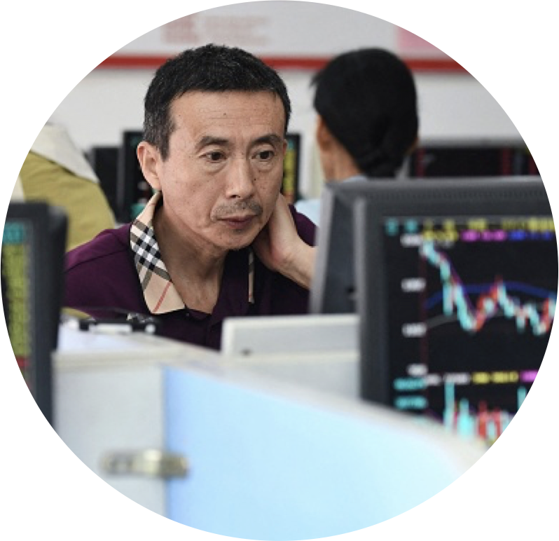
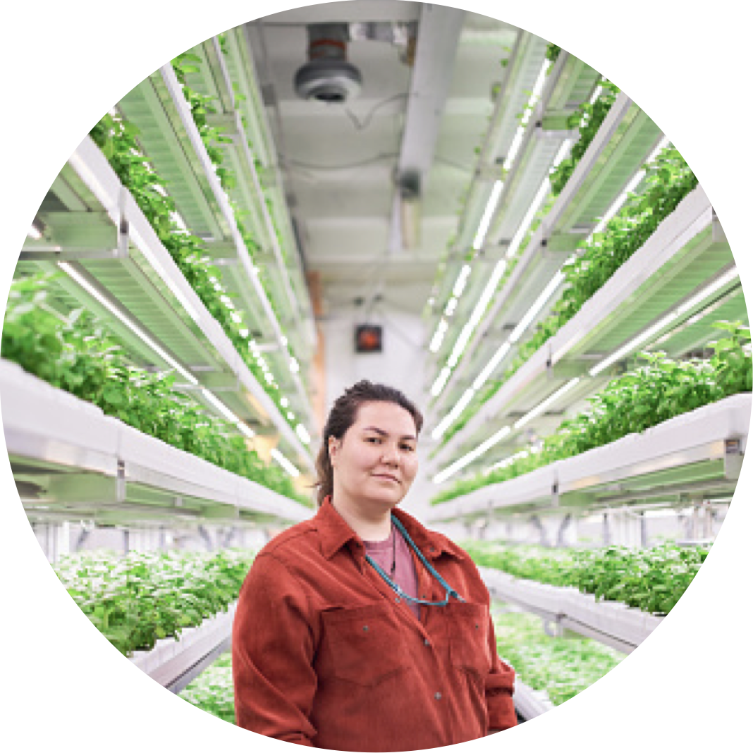
Overview of Bayer LinkedIn Channel & Strategy
Company Page
Showcase Pages
/// Bayer | Cardiopulmonary
/// Bayer | Ophthalmology
/// Bayer | Oncology
/// Bayer | Cardiopulmonary
Bayer | Pharmaceuticals
Bayer
Bayer | Consumer Health
/// Women | Bayer
/// Bayer | Innovation Ecosystem
/// Bayer | Co.Lab.
/// Bayer | AgPowered Services
Bayer | Crop Science
Climate
Bayer Foundation

Slide 6
Platform Target Audiences
On LinkedIn all of us are one Bayer—regardless of country, division, team, or channel. We have one Bayer's LinkedIn main page, that is managed jointly by comms teams (Content & Channels, divisional and country colleagues) and HR/Talent Acquisition team. While the main company page takes an overarching approach, showcase pages should apply their specific industry filter and offer unique topics, particular news and aspects of our business for distinctive target audience (i.e., Ag-minded, HCPs, etc.)
Financial Stakeholders & Media
These are institutional investors and media interested in Bayer corporate as well as divisions.
Opportunity to provide content positioning Bayer as a leader in health, nutrition and agriculture and engage with those interested in financial, corporate and divisional developments.
Through select corporate and HR messaging we showcase our workplace, inclusive culture and stories of personal developments, career journeys and exciting project work that is impactful and innovative.
Potential Talent
This includes talent for Bayer corporate as well as divisions in all areas.
Industry Professionals
This includes current employees, healthcare professionals, health retailers, farmers and researchers, scientists and academics.
Align Bayer’s mission of Health for all, Hunger for none with their professional and personal values. Share stories of innovation, thought leadership, highlight aspects of our business, and personalized updates.
14

Slide 7
How LinkedIn is Shifting in 2024:
📈 Prioritizing Engagement
Like other platforms, LinkedIn prioritizes highly engaging content. The more engagement a post receives, the more prominently it is promoted in user feeds. Comments volume matters to help make a post more discoverable!
👨‍💻 Shifting to Storytelling
While the platform remains highly catered toward professional networking, personal anecdotes and storytelling content has become some of the highest-performing content on the platform. Potential to elevate leader voices (sponsored content).
💡 Knowledge and Advice
LinkedIn has confirmed that posts that share “knowledge and insights” are now a priority for the LinkedIn algorithm. It is not focused on viral posts, but instead ensuring that the right people are seeing the right content for them. Posts are going to do better if they’re serving the reader in some way and appeal to desired audience.
🎥 Video Experiences
Aligning with the rise of short-form video content format across social media platforms, LinkedIn is testing a dedicated short-form video experience (UGC), which could impact content strategies. Favoring authentic over corporate feel and templated approach.
Notes:
In essence, the LinkedIn algorithm of 2024 rewards meaningful interactions and knowledge-sharing. To make the most of this algorithmic evolution, focus on creating content that adds value, fosters genuine connections, and aligns with your audience's interests and skills.
Sponsor content from thought leaders inside or outside of your company to build trust and credibility
Sponsor existing Articles you posted to a Company Page as single image ads
Organic Link Posts
As of late 2023, we decided to reduce the image size for organic third party links on posts. This is to encourage members to engage more with original commentary rather than off-site article links, and strike a better balance between original content on LinkedIn and external links. This change on LinkedIn is aimed at creating a more consistent and cohesive platform experience for our members by creating a more visually balanced feed that puts equal weight on the unique knowledge shared on LinkedIn and on the image preview. With this update, we're providing more opportunities for members to engage with each other's content, facilitating deeper connections and conversations. Additionally, by standardizing the image size across different types of posts, we're ensuring a smoother and more seamless browsing experience for our members, enhancing their overall LinkedIn experience.
While adapting to these changes, Page admins and members can enhance their posts by incorporating media along with links. By adding media such as images or videos, the content becomes more engaging and can potentially improve visibility.
Following these guidelines will help your shared content appear correctly and effectively in capturing attention on LinkedIn.
Ensure media has an aspect ratio between 3:2 and 16:9 to avoid being cropped
Avoid using borders since the thumbnails use rounded corners.
Avoid very long page titles, as titles exceeding two lines may be truncated with a "...".

Slide 8
5 Ways to Optimize Posts in 2024:
Write your LinkedIn posts for our target audience and based on goals, then optimize them for the algorithm. Not the other way around.
Frequency: post 2-4 times per week. Consistency is more important than frequency.
Interaction: the higher the engagement, the higher the chance of a wider reach on your LinkedIn Network. Engage with your posts for a min of 15 min after posting (the golden hour). Encourage comments, tag connections, ask questions to provoke a response, create posts on unique topics.
Mix: blend different post formats for a balanced and optimal content strategy.
Editing & Format: Text hooks, post formatting, and calls to action have a significant impact on engagement. Choose the format that works best for your goal.
LI videos: insights, tactics, events and storytelling content. Publish natively (rather than sharing a link), optimal engagement is 80-90 seconds. Add clear CTA at the end. Publish Tue – Thu, 11-1pm. Once per week is a good rule.
Rich text, articles: sweet spot is between 1,300 – 2,000 characters. Authentic and conversational tone, strong, original, questioning “hook” located in the first two lines of the post. Focus on single message, break into paragraphs with a maximum of 4 lines, optimize for readability.
Image relevance: PDF documents generate high reach. A visually relevant image, esp. featuring human beings, generates more reach and engagement. Upload media natively for link posts, since the image preview size has been reduced.
Notes:
Sponsor content from thought leaders inside or outside of your company to build trust and credibility
Sponsor existing articles you posted to a Company Page as single image ads
Ensure media has an aspect ratio between 3:2 and 16:9 to avoid being cropped
Avoid using borders since the thumbnails use rounded corners.
Avoid very long page titles, as titles exceeding two lines may be truncated with a "...".

Slide 9
Key Elements:
Copy Length
Community Engagement
KPIs
Strategic hashtag use, calls to action, LinkedIn Live events, comments on leader and employee posts. Engage with posts during the “golden hour” – first 60 minutes after a post is shared (for a min of 15 min).
Keep posts concise and to the point. Aim for 150-300 characters to capture attention. Long form should be 1,300 – 2,100 characters.
Measured by reactions, reposts, video view rate, click-through rate, total engagements, engagement rates.
Tone
Frequency & Timing
Mentions & Advocacy
Tone professional but relatable. Use active voice. Avoid jargon. Encourage exchange of ideas and thoughts; cautiously approach humor. Use empathetic language to help humanize the company. Speak to our community as intellectual peers.
2-4x per week, ensuring that posts provide value. Publish between 9-5pm on weekdays for higher engagement.
Tag collaborators, partners or individuals mentioned in specific post if he/she/they are active on LinkedIn. Encourage reposts via employee advocacy program.
SEO
Hashtags
Visuals
Optimize for search engines: use SEO techniques to improve ranking, visibility and traffic. Strategic headlines, engaging content and natural keyword usage are a must.
2 – 4 hashtags per post. Use sparingly, place strategically, keep them short and simple.
Visually relevant images, authentic, preferably personalized or infographics, meaningful selfies or featuring people. PDF documents up to 12 slides. Avoid stock images, screenshots or promotional visuals of products and services.
Format Types
Targeting
Visual content (multi-image, infographics, slideshows), videos, LinkedIn articles and text + image posts.
LinkedIn allows you to target posts to certain audiences and/or geographies. Countries can post on the global page and use targeting to reach their specific audience via native posting or Sprinklr.
Notes:
LinkedIn isn't just a platform for connecting with professionals; it's also a dynamic space for sharing valuable insights, networking, and building your personal brand. To ensure your LinkedIn posts reach a wider audience and make a lasting impact, it's essential to integrate SEO (Search Engine Optimization) techniques into your content strategy.

Slide 10
A Quick Follower & LinkedIn Analysis

Slide 11
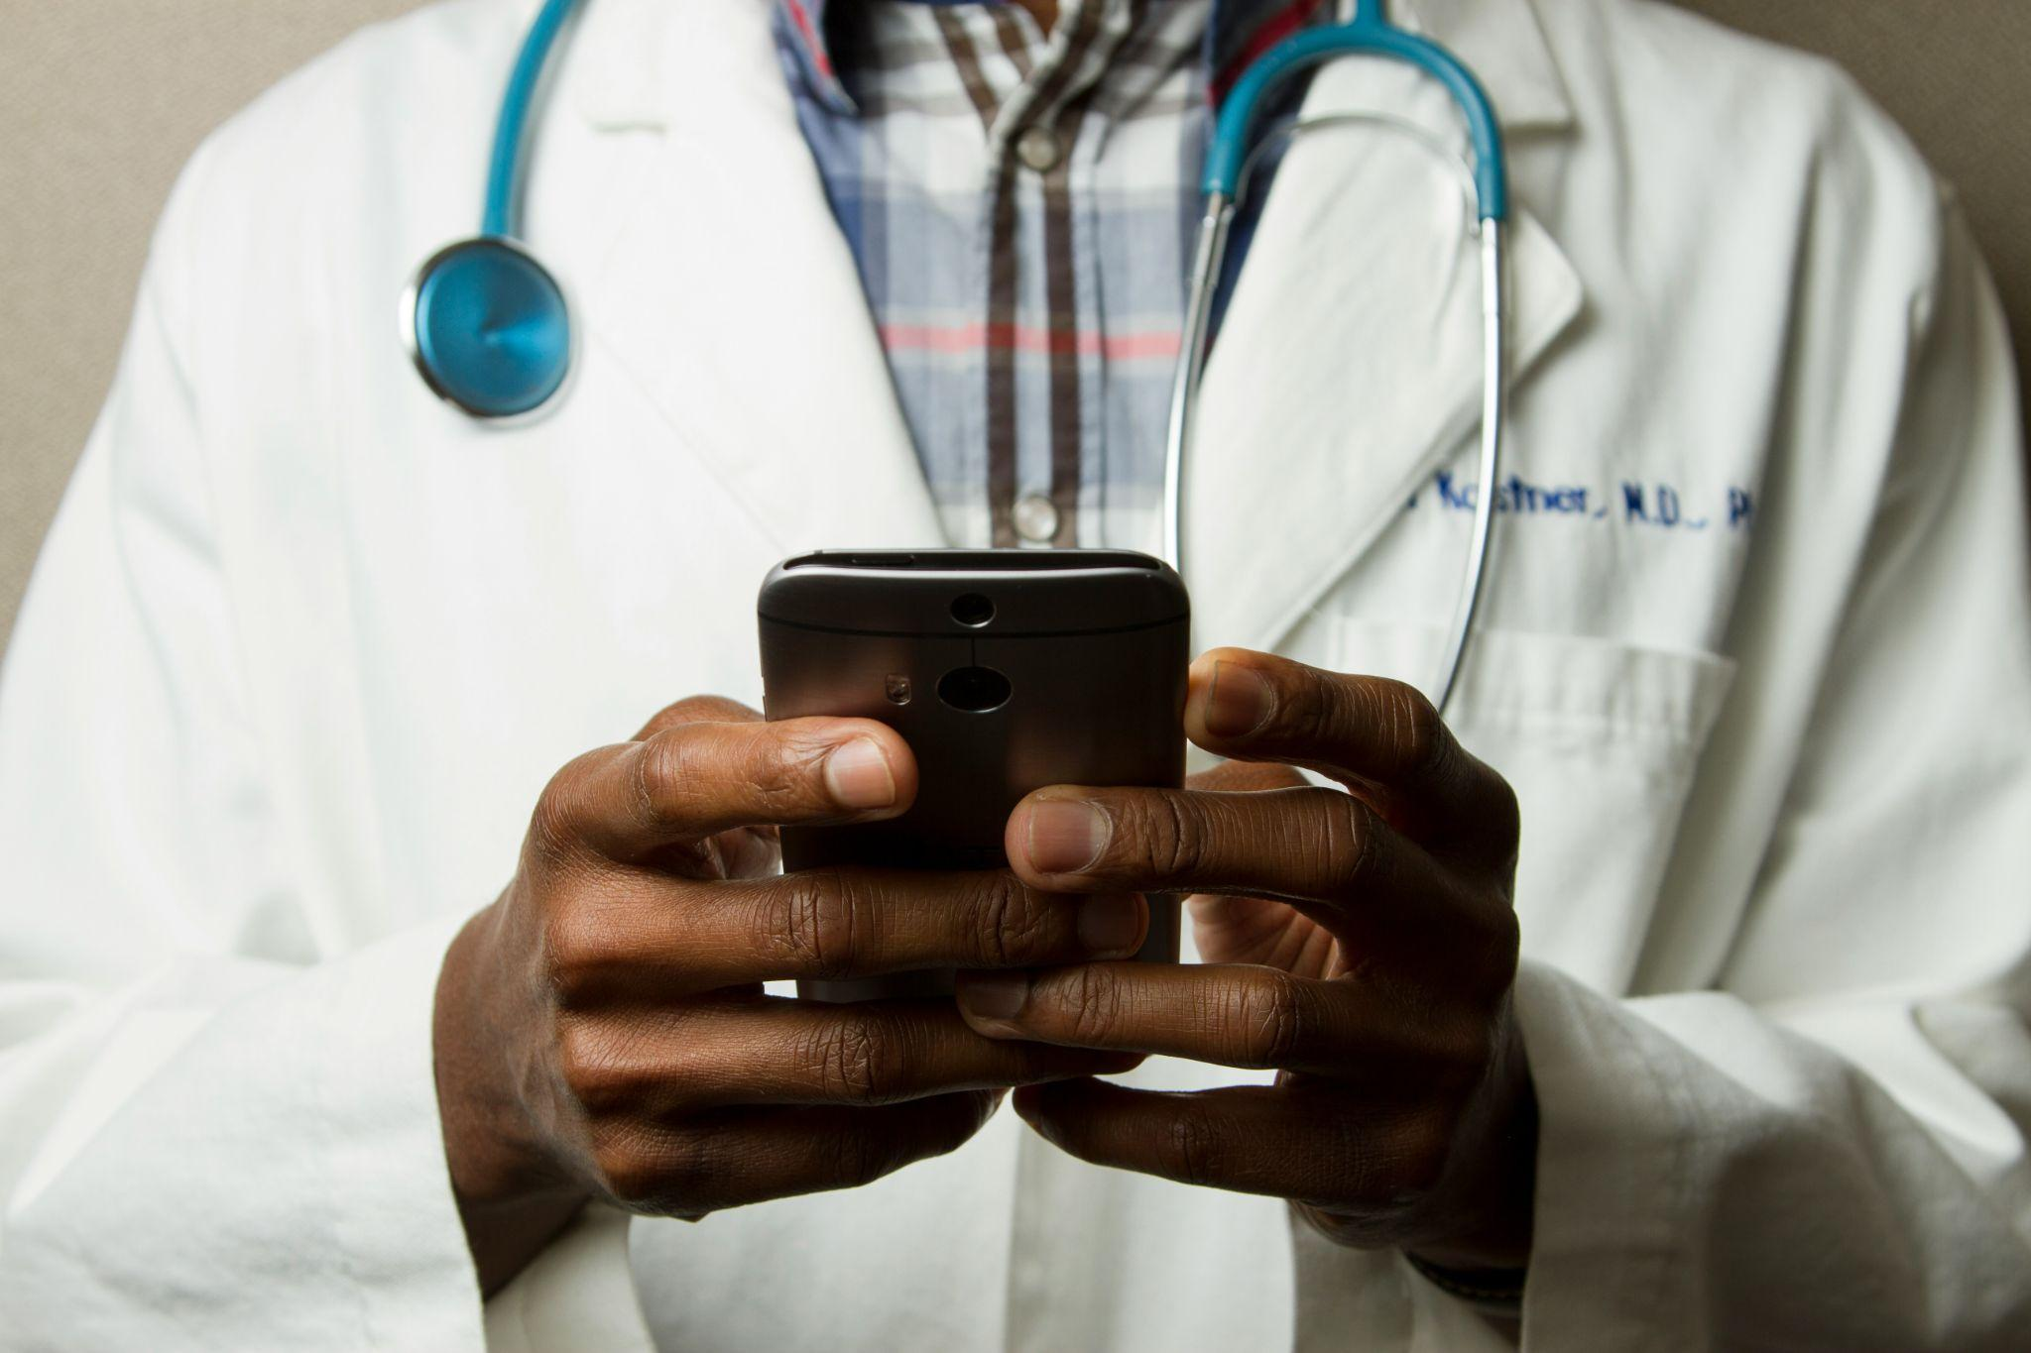
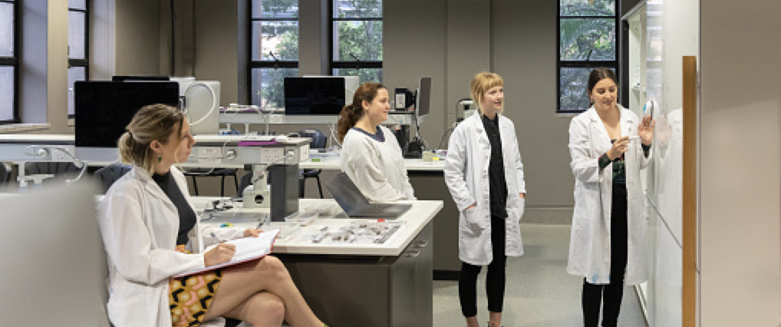
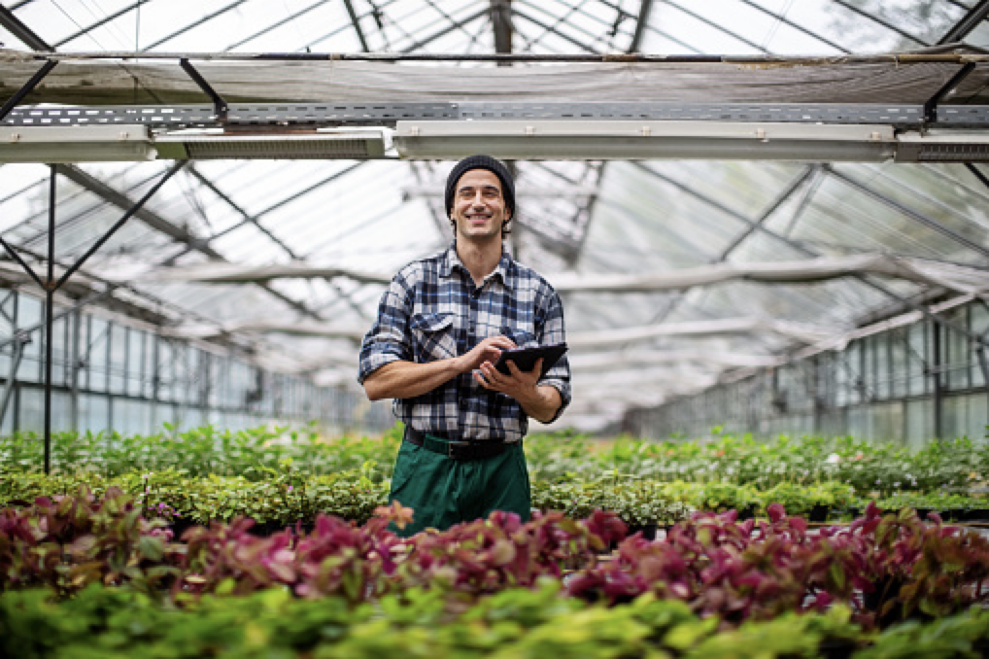
OUR FOLLOWERS
At a Glance
LinkedIn remains Bayer's most followed platform with almost 5.5 million followers.
Majority of our followers are professionals from the pharmaceutical/medial, IT and higher education sectors.
More of our followers fall into the Entry (1.8M) and Senior (1.6M) career levels.
Brazil, Argentina, USA, and India are the top follower countries.

Slide 12
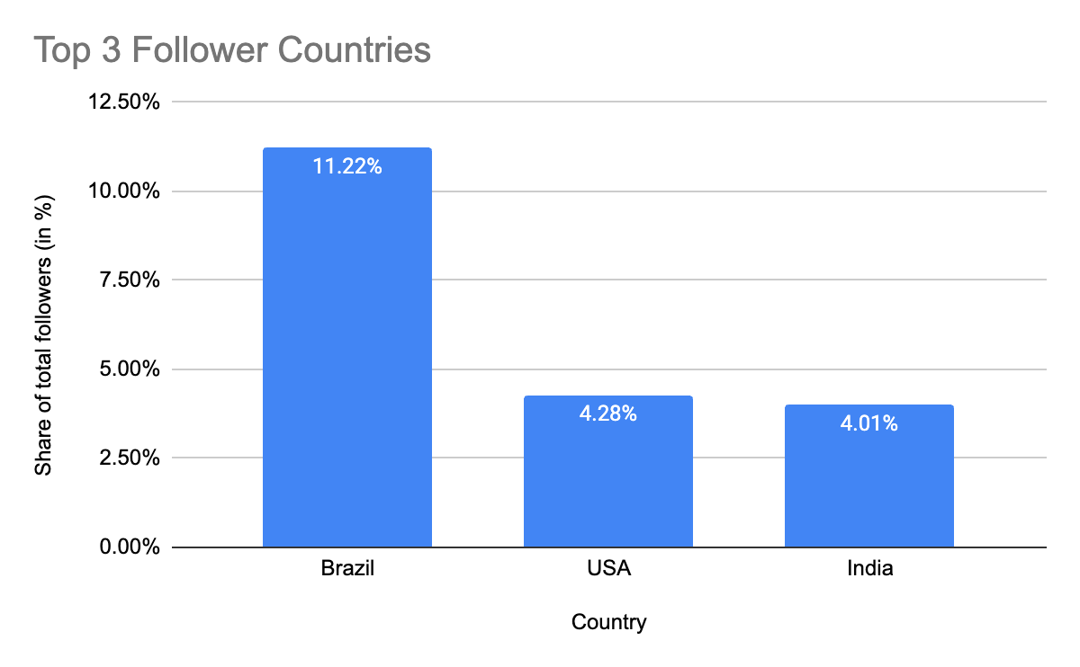
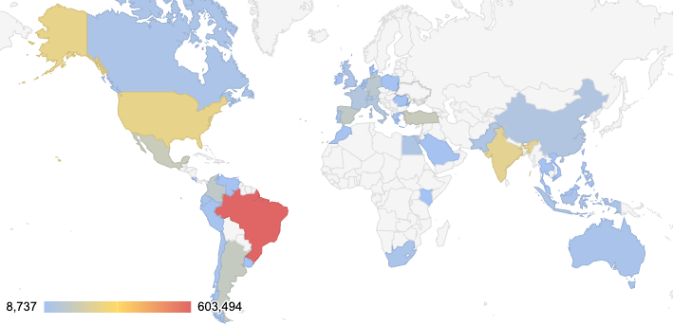
GEOGRAPHICAL BREAKDOWN
Continue to focus Globally & Locally
Note: Only 47% of followers list a country
Brazil, USA and India remain our top 4 follower countries on LinkedIn: Bayer's strategy can benefit from tailoring content to the cultural and health interests of its top follower countries: Brazil, the United States and India, Mexico and Turkey.
Top 10 cities are: 1. Greater Sao Paulo Area, Brazil 2. Greater Buenos Aires, Argentina 3. Mexico City, Mexico 4. Greater Istanbul, Turkiye, 5. Greater Rio de Janeiro, Brazil 6. Bogota, Colombia 7. D.C. Metropolitan Area, US 7. New York City Metropolitan Area, US 8. Greater Campinas, Brazil 9. Mumbai Metropolitan Region, India 10. Greater Madrid Metropolitan Area, Spain
Note: The LinkedIn follower data excludes users who list a city but not their country.

Slide 13
Top Performers & Key Takeaways

Slide 14
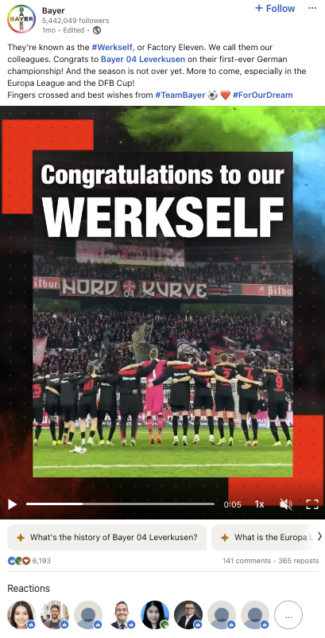
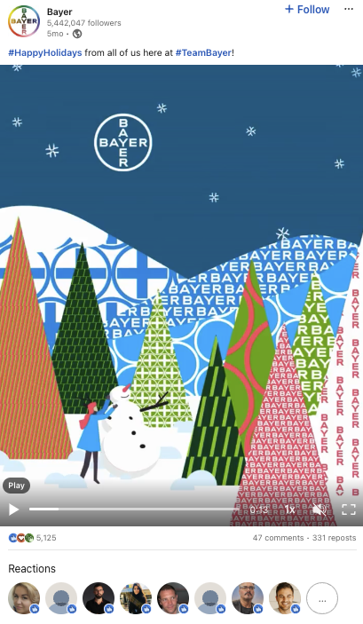
Can We Base Key Takeaways On Highest Performing Content?
Diving Into the Data:
Let’s take a look at the overall highest performing content
Look at 2-3 examples of topical posts that are best performers in terms of engagement
Taking into account engagement and reach benchmark from 2023
What actionable insights can we draw from these examples?
Happy Holidays
Engagements: 5,516
ER: 2.06%
ER Benchmark: 0.62%
Vertical video, simplicity
Holiday cheer, nod to the brand – can be used very rarely, may be limited to 1-2 times a year
Bayer & BlueRock Therapeutics
Engagements: 5,342
ER: 1.4%
ER Benchmark: 0.62%
Breaking news combined with topic of Parkinson's performs well due to the nature of the disease and Bayer’s work towards curing symptoms. Overall, innovation content does well on platform and it’s a given that relevant news should be shared
Bayer 04
Engagements: 6,465
ER: 1.73%
ER Benchmark: 0.62%
Vertical video, simplicity
Sports topics perform very well but should be treated as an exception since this is not our business focus
Notes:
These three posts (Bayer 04, Happy Holidays and Bayer & BlueRock Therapeutics —- April ‘23 - April 24 – had the overall Highest-Performing Content (based on Engagements and KPIs)

Slide 15
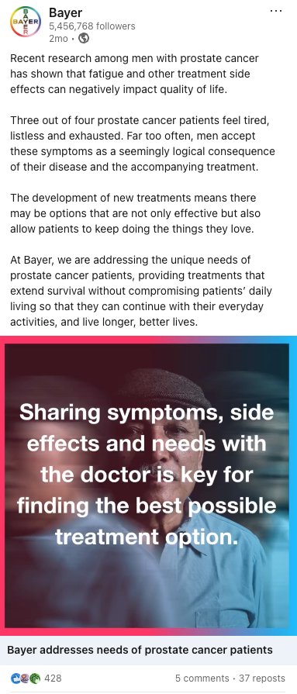
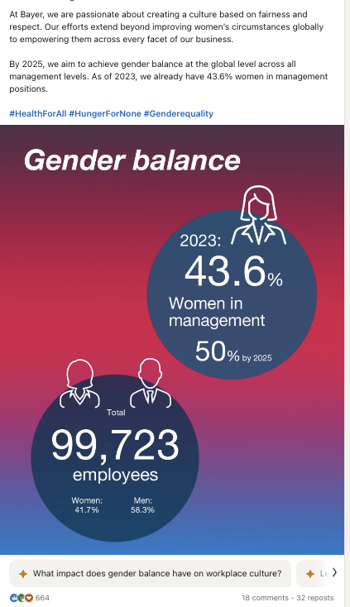
Diving Into the Data:
Analyzing six specific posts:
Gender Balance
Parkinson’s
Prostate Cancer
Contraception
Menopause
Direct Seeded Rice
Parkinson’s
Engagements: 658
ER: 1.02%
ER Benchmark: 0.62%
Short form video
Post was targeted
Parkinson's content performs well due to the nature of the disease and Bayer’s work towards curing symptoms (also applies to innovation content)
Gender Balance
Engagements: 714
ER: 1.25%
ER Benchmark: 0.62%
Gender balance is the least controversial of DEI topics and generally performs well on LI though it was a rather controversial topic on other channels
Prostate Cancer
Engagements: 471
ER: 1.21%
ER Benchmark: 0.62%
Content surrounding cancer can receive mixed sentiment due to legacy issues or personal negative experiences with the disease.

Slide 16
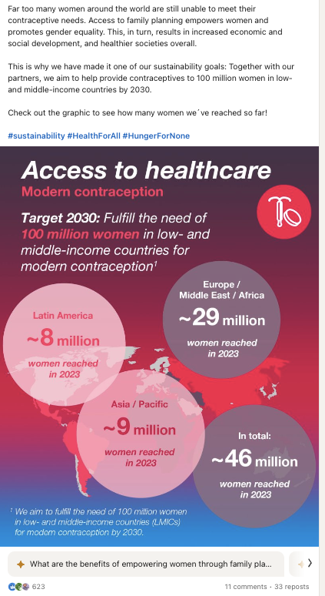
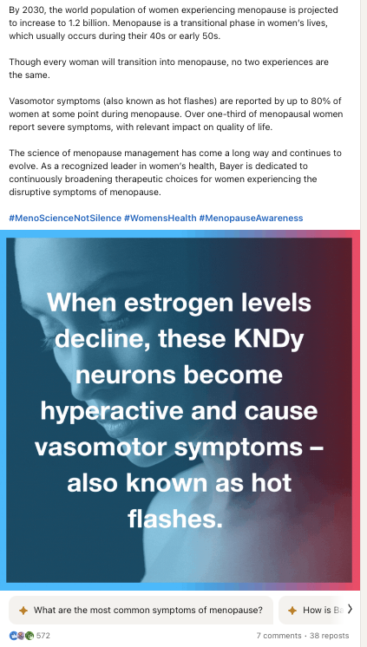
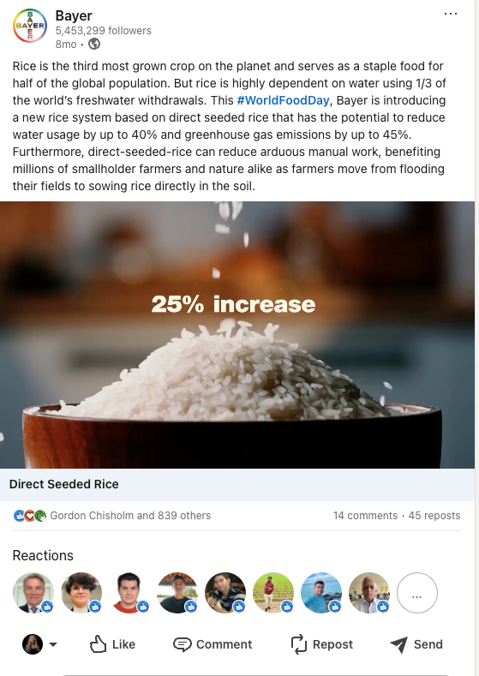
Direct Seed Rice
Engagements: 904
ER: 0.94%
ER Benchmark: 0.62%
Short form video, simplicity
Commitment to sustainability and innovation content is received well by users on LinkedIn, with many curious on Bayer’s tactics, how to join Bayer, or praise towards the company’s efforts
Contraception
Engagements: 667
ER: 0.82%
ER Benchmark: 0.62%
Access to contraception and women’s healthcare is a hot topic in the modern world
Menopause
Engagements: 617
ER: 1.20%
ER Benchmark: 0.62%
Women’s healthcare is a hot topic, especially menopause – performing very well, with comments and sentiment (trending topic)

Slide 17
Bonus: importance of employee advocacy
6 Quick Wins for Bayer’s LinkedIn Content
🤝 Based on Bayer’s Top Performing Content, We Recommend:
1
Posting topical, time-sensitive updates and industry insights to show that Bayer has a pulse on our industry. Share advice, words of wisdom & meaningful tips.
2
Sharing content to showcase Bayer’s activities and achievements, as well as its tangible impact on global events and broader world issues.
3
Continuing to create great employee-centric content, showing off Bayer culture and the human side of the company.
4
Emphasizing Bayer's leadership, commitment to sustainability and innovation, targeting topics that resonate with our key audiences, offering “knowledge and insights”.
5
Focusing on formats that perform well including animated and short form video content, and explore new formats, such as articles, multi-image and PDF documents.
6
Repurpose existing Bayer materials, such as web articles and videos, by updating and publishing natively to extend their reach and impact, minimizing the need for constant creation of new content and linking to the website.
Notes:
The importance of employee advocacy and the LinkedIn algorithm: employees play a big role that employees in winning reach from the algorithm through tactics like LinkedIn employee advocacy.
No links. Nothing salesy. Just a bit of advice or a quick story and that’s that.

Slide 18
This content spotlights Bayer’s business activities and accomplishments, ranging from notable milestones within specific divisions and product lines to overarching brand successes.
This content resonates with stakeholders and external audiences, effectively demonstrating how Bayer fulfills its mission of "Health for All, Hunger for None."
CONTENT THEME #1:
Bayer Activities & Achievements
Note: show off awards and accomplishments, without being boastful.
Notes:
5 tactics:
Know your audience – tailor your message accordingly
Lead with impact: describe the context of the achievement, the goal, steps taken to achieve the goal and the impact of the action
Express gratitude and appreciation, lift others. Make it a habit to recognize others for their hard work, help build culture of celebration and recognition
Tie the achievement to larger initiatives, to the contribution of something important
Be confident, use a positive and assertive tone, avoid phrases and words that imply superiority or comparison. Use humor or anecdotes to make achievements engaging and relatable

Slide 19
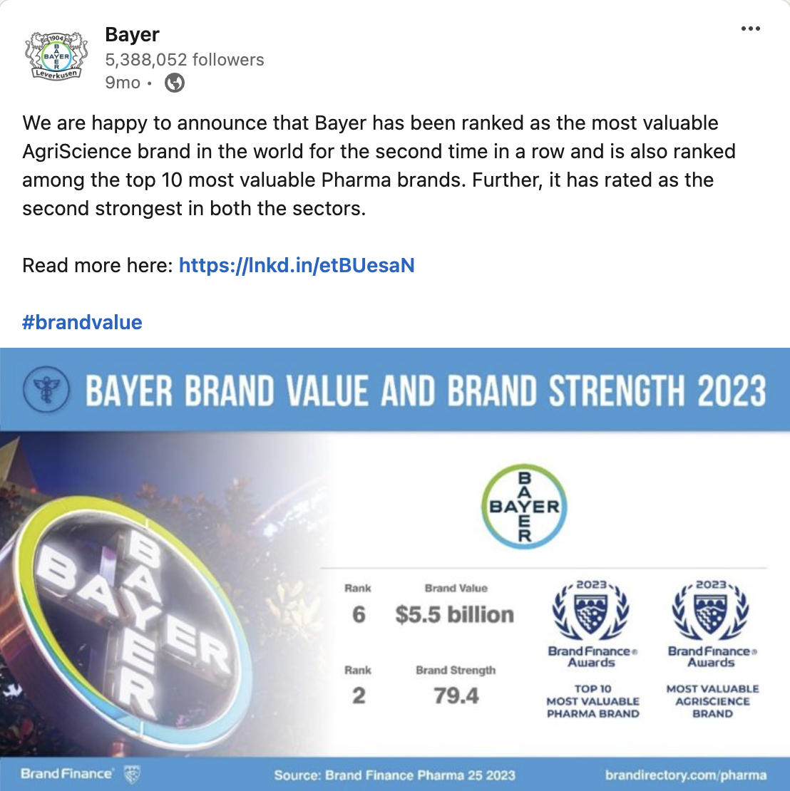
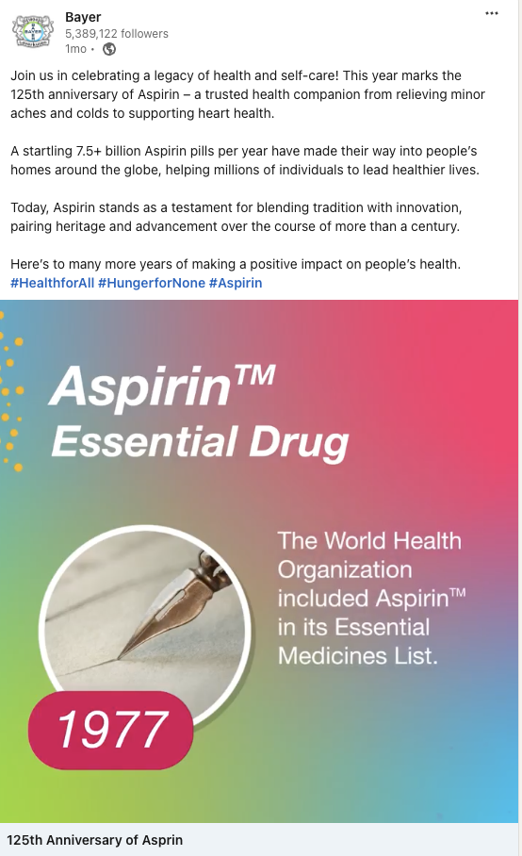
Bayer Activities & Achievements
Why it works:
Exciting brand news, enticing to all key audiences
Leaders and employees want to share, which expands reach
Reinforces Bayer’s value
Provides key information in the copy and creative asset
204K impressions, 4K likes
Why it works:
Celebrates a brand name that is easily accessible and recognizable
Reinforces Bayer’s legacy
Appeals to multiple audiences - point of pride for stakeholders, internal audiences
Animation / video format consistently performs well
86K imptessions, 30K views, 1.5K likes
AgriScience Ranking
125th Anniversary of Aspirin

Slide 20
They stand out by not directly promoting Bayer but instead create a meaningful connection between Bayer and current global events or trending topics, enhancing our connection with followers and showcasing our agility, responsiveness and awareness.
They appeal to both internal and external audiences by showcasing the company's altruistic efforts and global engagement.
CONTENT THEME #2:
World Events & Bayer’s Impact

Slide 21
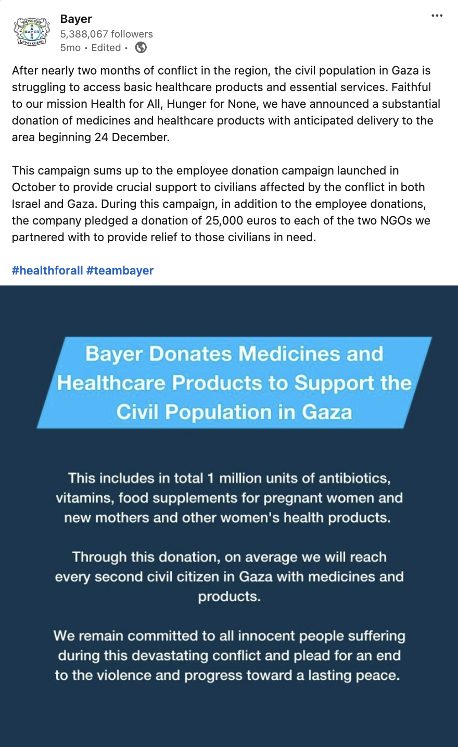
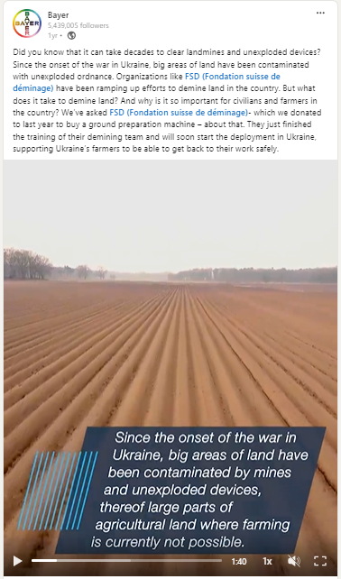
World Events & Bayer’s Impact
Gaza Aid
Why it works:
Newsworthy impact
Extends beyond typical Bayer news, touching on significant, current global issues, which attracts broader interest.
Demonstration of tangible impact aligning with Bayer’s mission of social responsibility
Reinforces Bayer’s values and community engagement
Ukraine Aid
Why it works:
Newsworthy and educational impact
Collaboration with other organizations (ground preparation machine donation to FSD)
Demonstration of tangible impact aligning with Bayer’s mission of social responsibility
Goes behind the scenes and showcases our commitment

Slide 22
CONTENT THEME #3:
Culture at Bayer posts give an inside look at Bayer’s internal community. These posts highlight Bayer’s mission and values in internal and employee-driven examples. The format of these posts should be fun, engaging and sometimes a “behind-the-scenes” look at Bayer.
Culture at Bayer

Slide 23
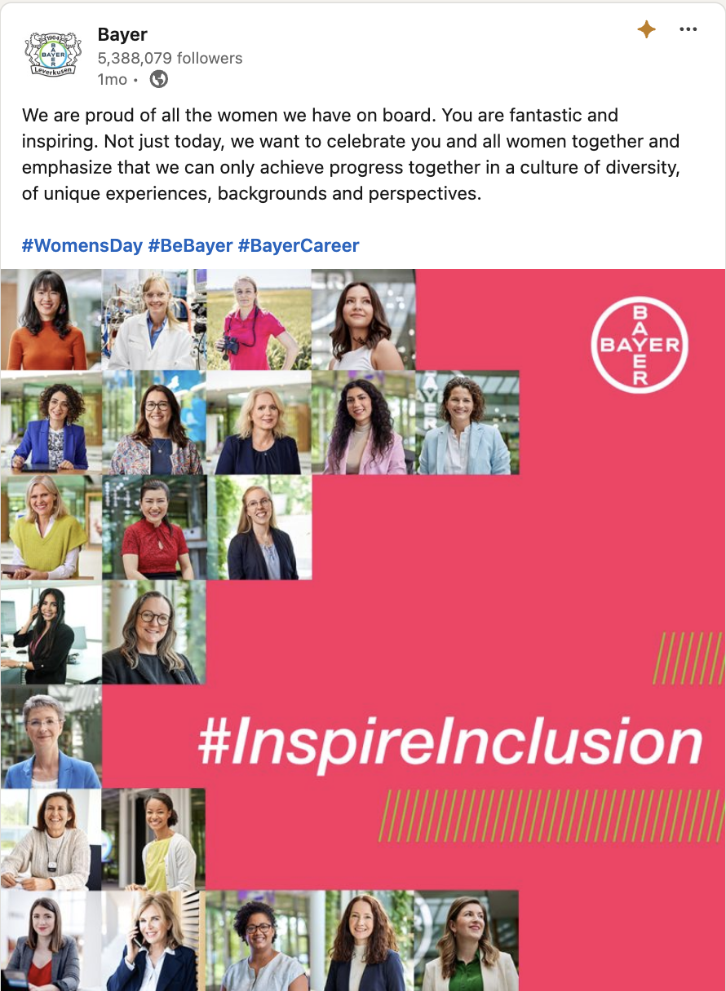
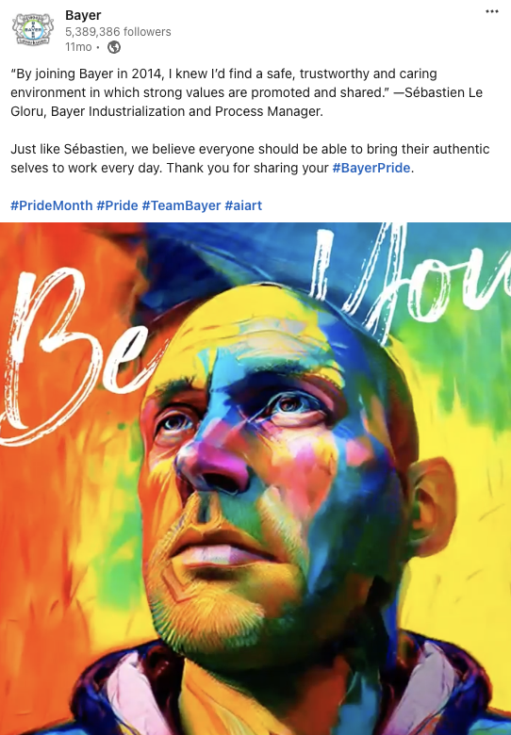
Culture at Bayer
Why it works:
Targets internal audiences with feel-good message fostering a positive workplace culture
Highlights DEI efforts at Bayer
Relatable to larger audience due to these being a widely recognized international holiday
Human-centric messaging message more relatable and engaging for the audience
Features real faces of Bayer employees enhancing authenticity
Bold, bright colors that are eye-catching
Women’s Day & Pride Month

Slide 24
CONTENT THEME #4:
These posts highlight Bayer’s industry leadership and commitment. They feature real-world examples of Bayer's impactful sustainability initiatives and groundbreaking innovations, and may include thought leadership pieces that position Bayer as an authoritative voice in its key sectors.
Additional opportunity is to provide unique proof points that Bayer offers to the industry (for example, diversity in clinical trials)
Sustainability & Innovation

Slide 25
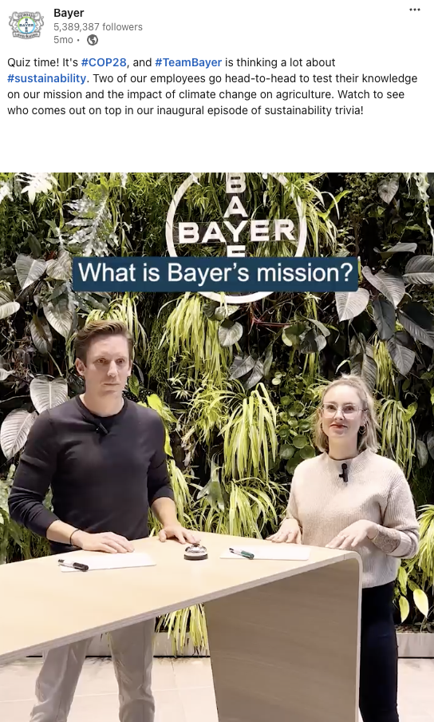
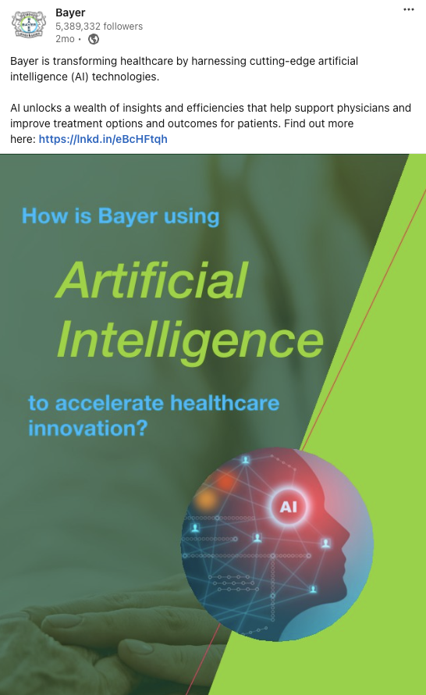
Sustainability & Innovation: Top Performers
Why it works:
Targets internal employees, fostering a sense of community and participation
Showcases real people, adding a personal, relatable element
Utilizes a fun format that captivates and entertains a wider audience
Animation / video format consistently does well
Focuses on sustainability, a subject that resonates widely and is currently trending globally
Why it works:
Focused on AI, a highly relevant and buzzworthy topic, capturing widespread interest
Appeals to stakeholders and external audiences by positioning Bayer at the forefront of technological innovation
Effectively promotes Bayer’s mission within the context of major world developments
Underscores the company’s role in shaping the future of healthcare
#COP28 Sustainability
AI Innovation

Slide 26
How We Increase Content Performance in the Long Run

Slide 27
Increase Content Performance
Users come to LinkedIn for a window into Bayer's culture and people, humanizing the company, and reading thought leadership.
LinkedIn algorithm of 2024 rewards meaningful interactions and knowledge-sharing…
🌿 Developing valuable, evergreen content
📝 Creating storytelling content geared toward connection and authenticity
🎥 Publishing more short-form video content
🎨 Using consistency in core brand elements / Bayer design system without looking too engineered and/or corporate

Slide 28
LinkedIn is shifting its focus towards maximizing user value within the app, potentially extending the shelf-life of content. This change presents an opportunity for Bayer to adapt its strategy in the following ways:
Focus on Evergreen Messaging:
Prioritize content that remains relevant and valuable over time, including copy that is not focused on a specific time or date.
Unique, Impactful Content:
Produce content that deepens knowledge in specific areas of interest, helping audiences enhance their expertise.
In-depth, Exclusive Insights:
Share detailed and insightful posts that offer unique information unavailable elsewhere, establishing Bayer as a go-to resource in its fields.
ENGAGEMENT TACTIC #1:
🌿 Valuable, Evergreen Content
Notes:
Sanofi Does a Great Job with Evergreen content:
Articles (Leader Voices):
Paris Olympics https://www.linkedin.com/posts/sanofi_ignitingpotential-paris2024-teamsanofi-activity-7148658941965606912-R-wS?utm_source=share&utm_medium=member_desktop
Flu vaccine recommendations, specifically for older people who are the most at risk - https://www.linkedin.com/posts/sanofi_as-we-grow-older-we-all-become-more-vulnerable-activity-7114194780070260737-7hzx?utm_source=share&utm_medium=member_desktop
What Makes Unilever Unique? Video: https://www.linkedin.com/posts/unilever_unileverusa-uniquelyunilever-lifeatunilever-activity-7186815757802962944-j02l?utm_source=share&utm_medium=member_desktop

Slide 29
While professional and networking posts remain important, there's a growing appetite for content that tells a story and evokes emotion. Storytelling connects with audiences on a deeper level than data alone, helping people understand the world, relate to the Bayer brand, and retain information.
Bayer can leverage this trend by:
Targeting Audience Interests:
Align content with the desires, concerns, interests, and preferences of key audiences, tailoring content to resonate with both Entry and Senior level employees.
Humanizing Content:
Incorporate stories and photos of real people to add a personal touch, and leverage a personal tone to make posts more relatable and engaging.
Amplifying Leader Voices:
Share insights and stories from Bayer leaders to add authenticity.
Combining Cutting-Edge Info w/ Storytelling:
Integrate the latest industry news and innovations with narrative techniques to create compelling stories. This approach helps in bridging the gap between dry, factual content and engaging, relatable storytelling.
ENGAGEMENT TACTIC #2:
📝 Storytelling Content
Notes:
Humanizing Content
Pfizer Long COVID:
https://www.linkedin.com/posts/pfizer_in-march-2020-tammy-wilshire-was-sick-with-activity-7186078627254427648-pLJD?utm_source=share&utm_medium=member_desktop
Pfizer Breast Cancer: https://www.linkedin.com/posts/pfizer_outdo-yesterday-and-attack-cancer-from-all-activity-7161011354697392128-OAlJ?utm_source=share&utm_medium=member_desktop
Combining Cutting Edge Info w/ Storytelling
Pfizer Seagen Approval https://www.linkedin.com/posts/pfizer_now-approved-activity-7141780978330472448-EMU3?utm_source=share&utm_medium=member_desktop
Pfizer Hemophilia B Video Post: https://www.linkedin.com/posts/pfizer_beqvez20fdamp4-activity-7189589523696156674-jKzA?utm_source=share&utm_medium=member_desktop
Pfizer Annual Report https://www.linkedin.com/posts/pfizer_annualreview-activity-7174104556014833665-RlOp?utm_source=share&utm_medium=member_desktop

Slide 30
Following trends set by other platforms, LinkedIn is enhancing its focus on short-form videos, which are not only prioritized by the algorithm but also cater to the brief attention spans of users. Bayer can capitalize on this shift by:
Creating Video Snippets:
Develop short versions (15-60 seconds) of longer-form content, making complex information more digestible.
Developing UGC Videos:
Embrace user-generated authentic video content that adheres to platform best practices, featuring employees, showcasing personalities in an interview or a selfie-mode.
Engaging and Humanizing Content:
Draw inspiration from successful initiatives like the COP28 video to craft content that is both fun and engaging, effectively humanizing the Bayer brand and showcasing its personality.
ENGAGEMENT TACTIC #3:
🎥 Short-form Video Content,
Animations & GIFs
Notes:
Sanofi does a great job with diversifying their styles within their LinkedIn video content, still remaining true to Sanofi design system
https://www.linkedin.com/posts/sanofi_ai-healthcare-netzero-activity-7190727874054696960-I9cY?utm_source=share&utm_medium=member_desktop https://www.linkedin.com/posts/sanofi_meet-our-rutgers-university-fellows-activity-7191421246381699072-RxNz?utm_source=share&utm_medium=member_desktop
https://www.linkedin.com/posts/sanofi_healthequityheroes-patientadvocacy-amillionconversations-activity-7191060923061608448-GkR-?utm_source=share&utm_medium=member_desktop
https://www.linkedin.com/posts/sanofi_pursue-progress-activity-7184520988250787840-Dr3z?utm_source=share&utm_medium=member_desktop

Slide 31
Most users encounter content through their Feed, shared posts from connections, or suggested content that gains significant traction. Implementing the Bayer design system can significantly enhance your brand's visibility on the platform. Given that multiple individuals may post from Bayer's LinkedIn page, it's critical to ensure universal access to this design system to maintain consistency across all communications:
Quality in Visuals:
Maintain good quality across all video content and photography to present a unified and professional image. Use your best judgement when creating intentionally lo-fi videos as well: best quality possible while keeping it feel authentic and not over-produced or corporate.
Design Consistency:
While logo use is not always necessary, consistent use of Bayer’s bold and vibrant color palette and distinct typography is essential.
ENGAGEMENT TACTIC #4:
🎨 Bayer Design System
Notes:
Johnson & Johnson does a fantastic job with this:
https://www.linkedin.com/company/johnson-&-johnson/posts/?feedView=all

Slide 32
Appendix
Quick Analysis of LinkedIn
May 2024

Slide 33
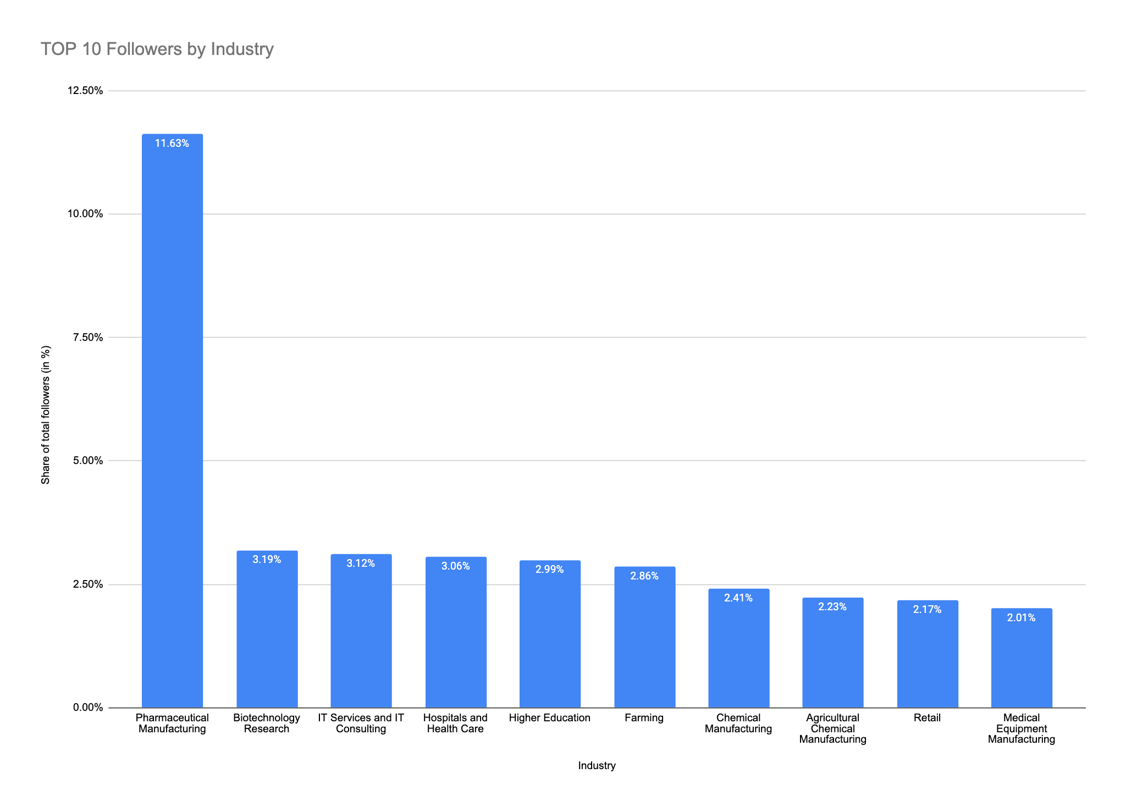
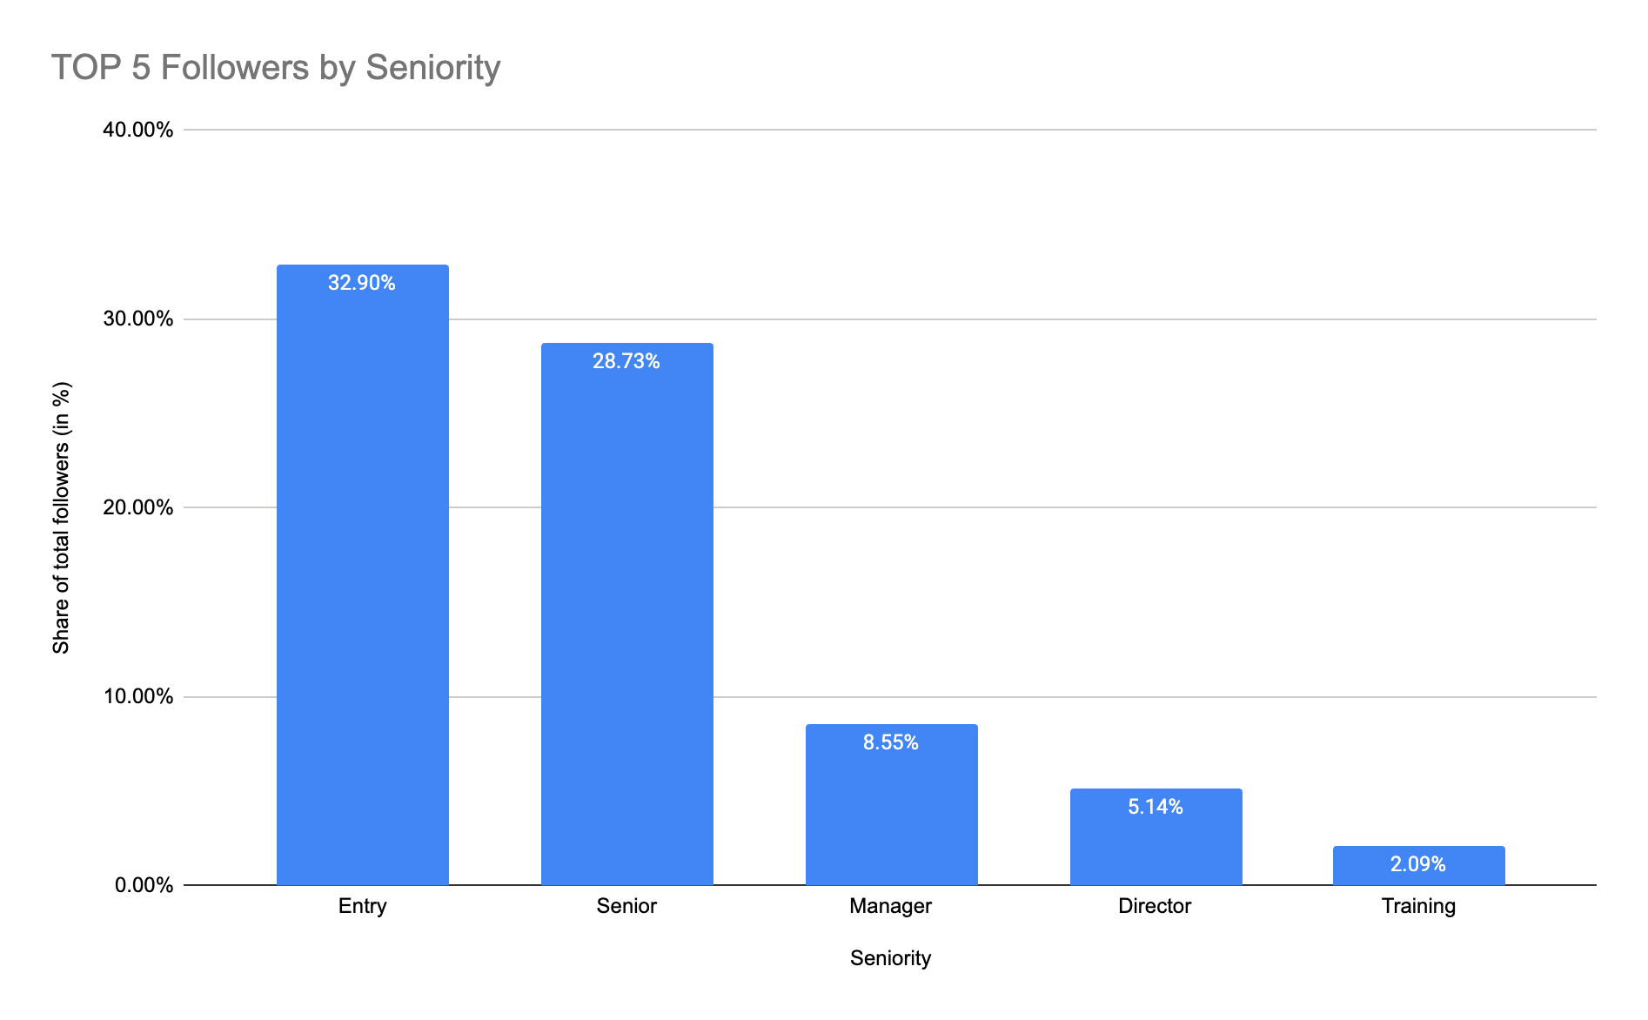
GEOGRAPHICAL BREAKDOWN
More Followers Come from Pharma/Medical Backgrounds Compared to Crop Science
We see more ‘Pharmaceutical Marketing’ // ‘Biotechnology Research’ // Hospitals and Health Care’ industry followers vs. Crop Science based professions like ‘Farming’ or ‘Agricultural Chemical Manufacturing’
Majority of our followers fall within ‘Entry’ and ‘Senior’ level employees.
From LinkedIn “a Senior Product Marketing Manager has a seniority of Manager, an Associate Consultant has a seniority of Entry, and a Doctor or Physician would be classified as a Senior Individual Contributor.”

Slide 34
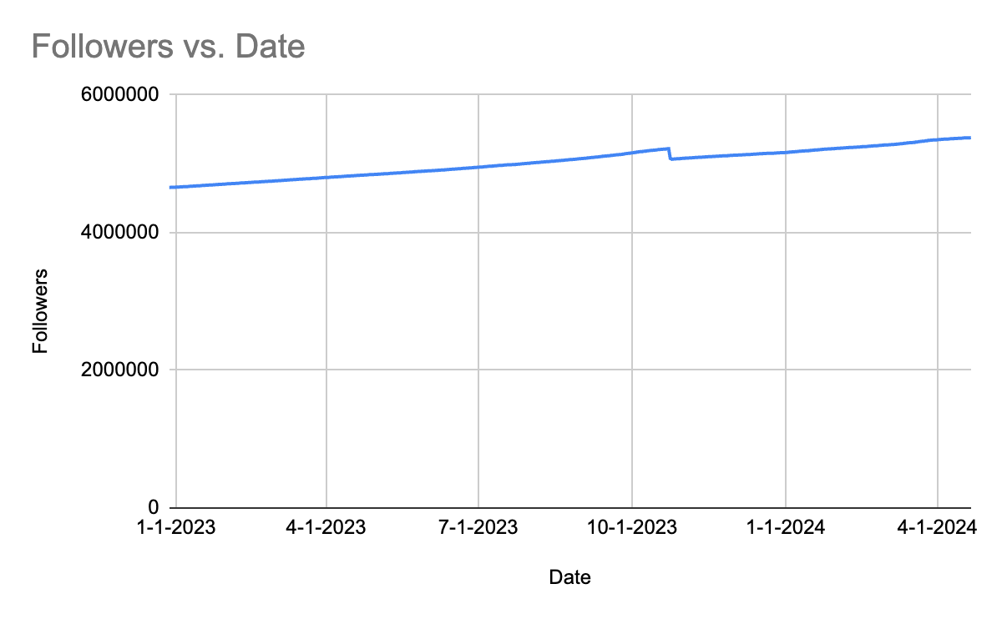
GEOGRAPHICAL BREAKDOWN
Bayer’s Main LinkedIn Page has 5.44M LinkedIn Followers (& Climbing!)
Data Date Range: 3/21/2024 - 4/19/2024
Page | Total Followers | New Followers | Total post engagements | Total posts
Bayer | Consumer Health (Showcase Page) | 17,945 | 565 | 1,518 | 12
Bayer | Crop Science (Showcase Page) | 87,8523 | 7,191 | 3,708 | 15
Bayer | Pharmaceuticals (Showcase Page) | 1,765,160 | 14,096 | 4,597 | 35
Roche | 3,263,063 | 36,645 | 11,191 | 48
GSK | 3,950,428 | 40,960 | 18,342 | 80
Sanofi | 3,951,681 | 43,144 | 45,607 | 279
Bayer (Main Page) | 5,378,916 | 68,937 | 44,782 | 236*
Pfizer | 5,796,918 | 60,653 | 19,992 | 178
Johnson & Johnson | 8,915,476 | 67,153 | 19363 | 50
Nestlé | 15,331,156 | 133,168 | 51,746 | 327
Unilever | 19,141,723 | 120,063 | 73,086 | 198
LinkedIn removed millions of inactive users in October 2023
We consistently see a steady climb of LinkedIn followers YoY.
Out of our category competitive segment, only Pfizer, Johnson & Johnson, Nestlé and Unilever have more followers than Bayer’s main LinkedIn page.
*236 posts over the last months includes all Country geo targeted posts.

Slide 35
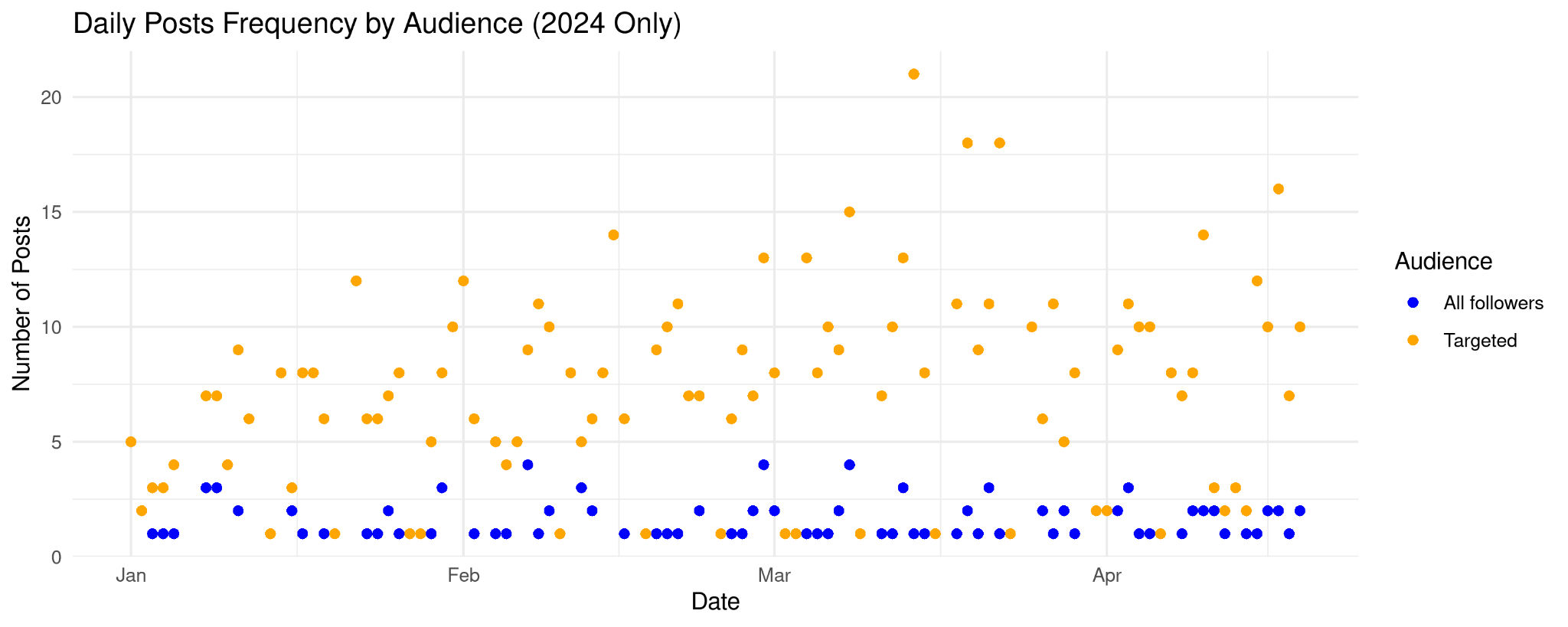
Current LinkedIn Frequency / Cadence

Slide 36
Engagement & Reach Benchmarks (04/’23 - 04/’24)
Diving Into
the Data:
Benchmarks help us set goals and control performance expectations, monitor performance, and improve Bayer content.
Benchmarks are traditionally measured as Mean/averages (comparing average score for this year vs. average score for last year) but in this instance, we recommend defining our benchmark as the Median score.
Benchmark | LI Engagements (Likes, comments, shares) | LI Engagement Rate
Range/Span: | 0 - 6465 | 0% - 20%
Mean (average): | 447 | 0.74%
Median (middle): | 271 | 00.62%
Our Native LinkedIn data is skewed due to the fact Bayer uses its Global LinkedIn page for all regional posts and Global posts. Most posts generated very few engagements and there are a few posts with extremely high engagements (outliers). Therefore, Paradowski recommends looking at the Median as a reference.
Notes:
Benchmarks are traditionally measured as AVERAGES: you are comparing the average score for this year vs the average score for last year. Source: https://support.b.co.uk/s/article/What-are-benchmarks-and-how-are-they-calculated

Slide 37
Data Source For Top Performers and Followers:
Full Spreadsheet of LinkedIn Data on Paradowski Sharepoint
LinkedIn Native Platform Analytics Data Date Range: Jan 1, 2023 - March 31, 2024
Reference Links:
2023 Channel Landscape / Community Analysis
Dynamic Shared Ownership (DSO) https://www.bayer.com/en/strategy/strategy
2023 Bayer Group Channels Reports
○ Jan – June H1 2023
○ July – September Q3 2023
Recent Channel Feature Updates
Overall Bayer Social Channels Hashtag Strategy
SEO – Search in Social Documentation
○ On Channel Search vs. SEO on Google/Bing – See here
The Rise and Importance of Vertical Video Documentation
○ Reels Research
○ Vertical Video POV

